Slide 1
How do early childhood educators foster social-emotional development?
Literature Review Presentation
Marlo R. Hornsby
Shawnee State University
7001 OTD
Dr. Stone
December 5, 2024
Trademarked Logos | Shawnee State

Slide 2
Findings from the Literature Review
What are calming corners?
Frameworks
Social Emotional Development

Slide 3
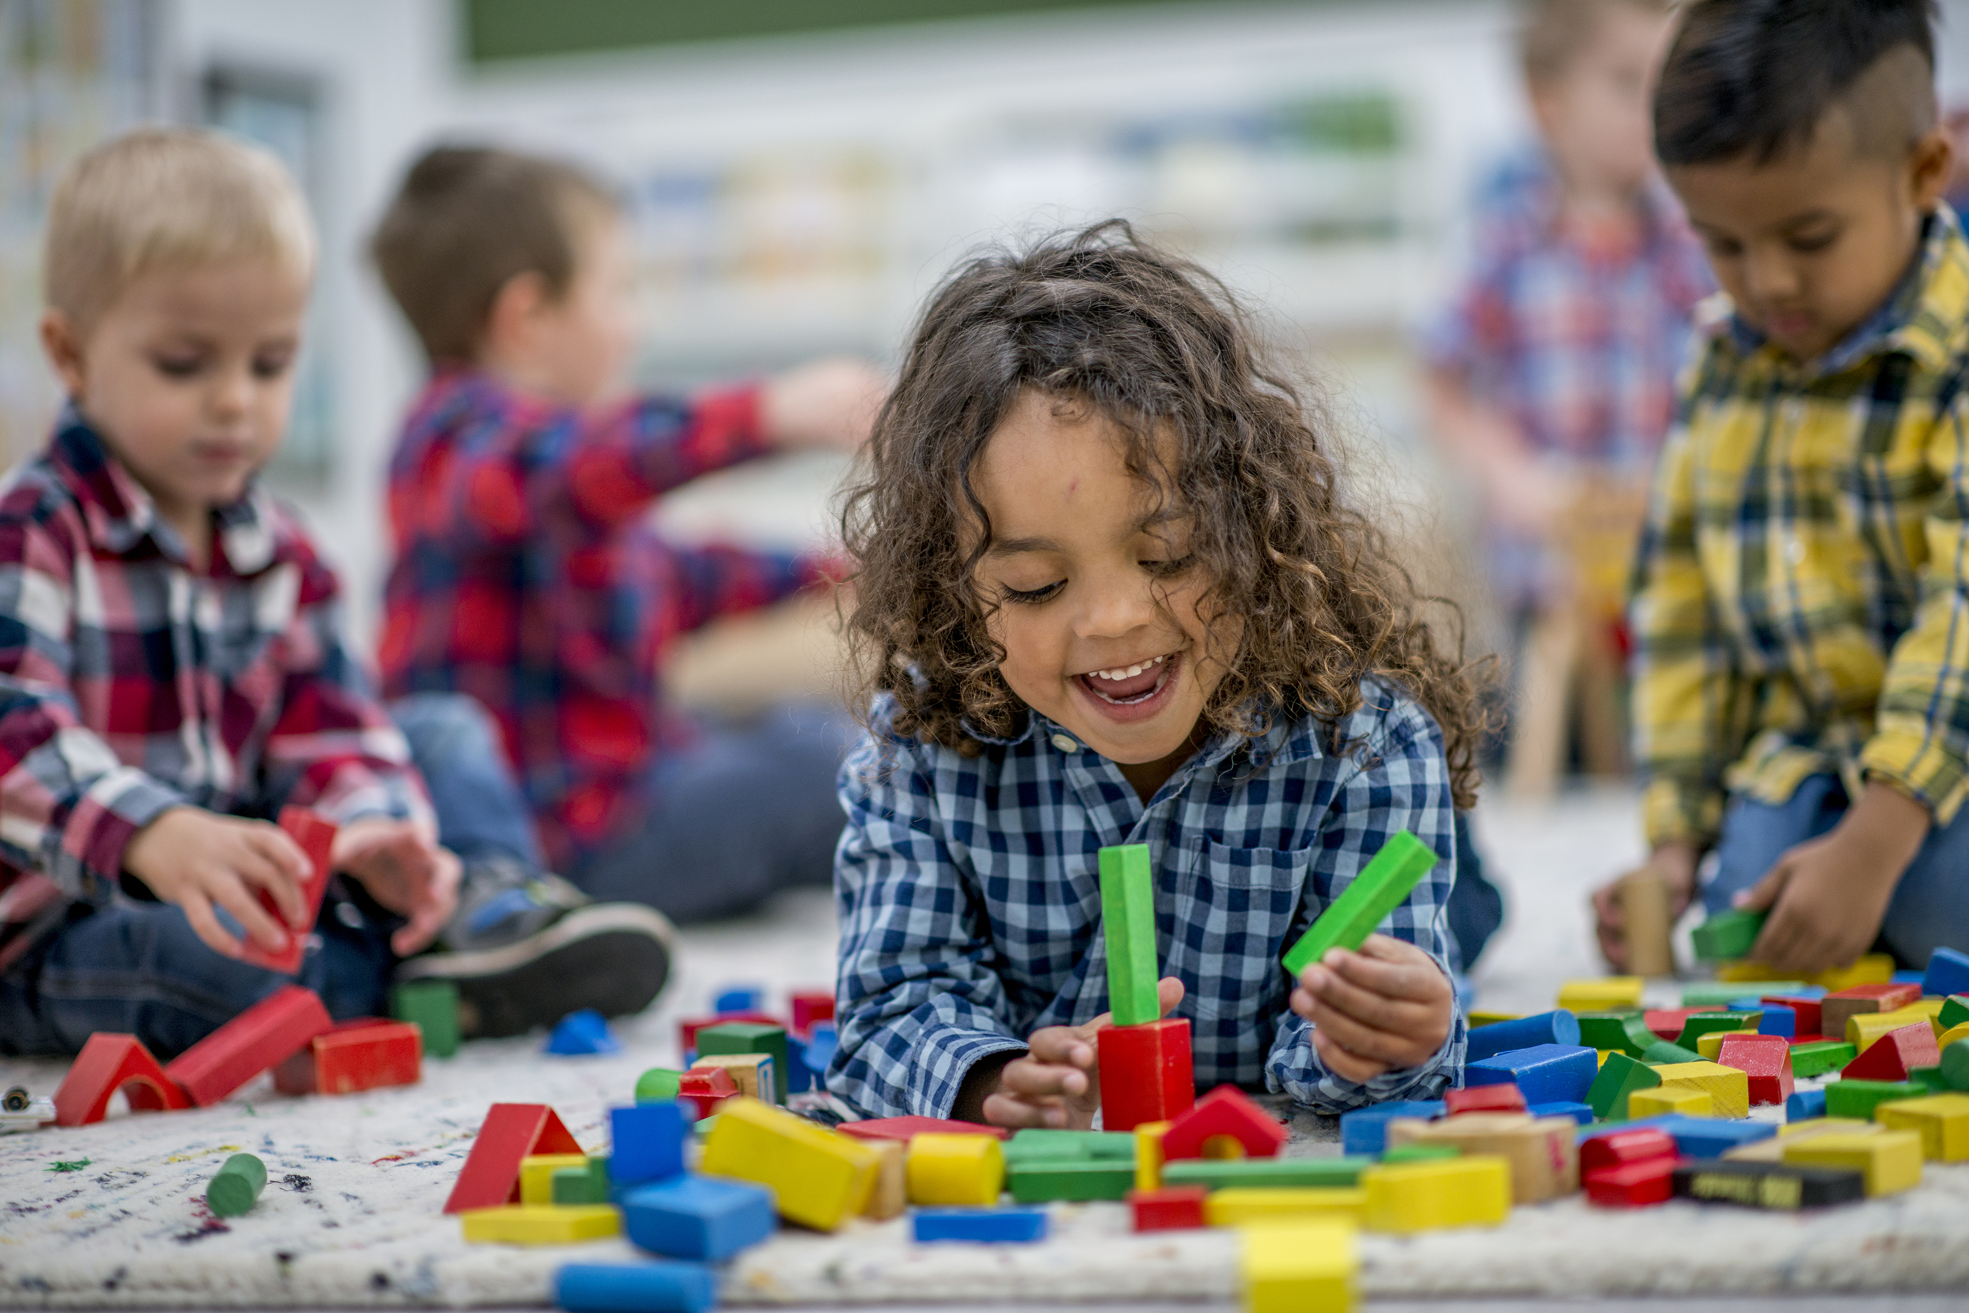
Gaps within the literature

Slide 4
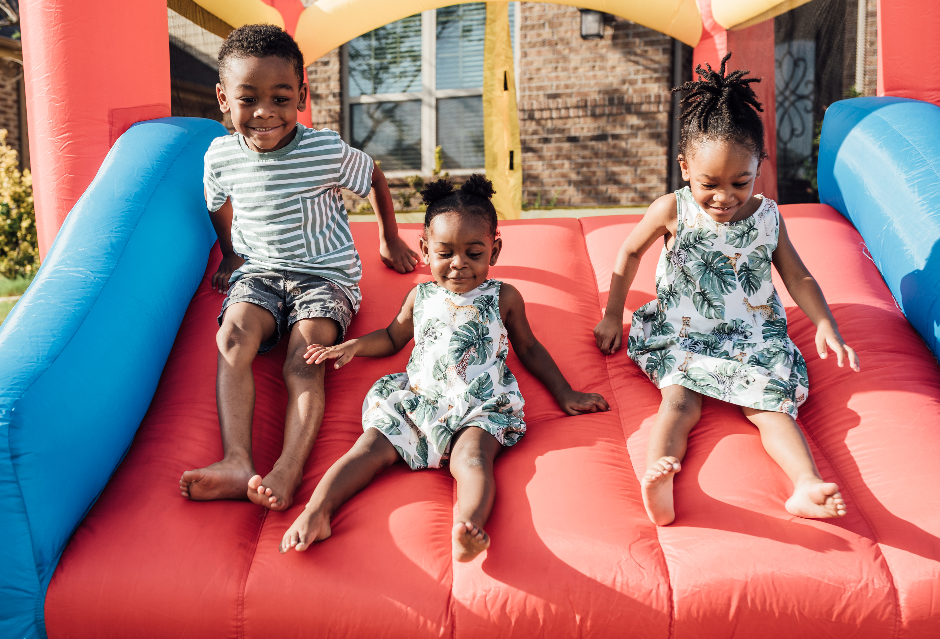
Problem Statement:
Preschool teachers often face significant challenges in addressing the self-regulation and social-emotional needs of their students. These skills are foundational for young learner’s overall development, influencing their academic success and interpersonal relationships.
Notes:
Introduction

Slide 5
Significance of the problem
Social-emotional learning
Calming Areas
Imagine if preschool classrooms had evidence-
based guidelines for creating spaces that enhance
emotional regulation. What would that mean for
children’s long term well being and success?

Slide 6
References
Case-Smith, J. (2013). Systematic Review of Interventions to Promote Social–Emotional Development in Young Children With or at Risk for Disability. The American Journal of Occupational Therapy, 67(4), 395–404. https://doi.org/10.5014/ajot.2013.004713
Ferreira, M., Reis-Jorge, J., & Batalha, S. (2021). Social and Emotional Learning in Preschool Education - A Qualitative Study with Preschool Teachers. International Journal of Emotional Education, 13(1), 51–66.
Gillespie, L. (2015). It Takes Two. YC: Young Children, 70(3), 94–96.
Hemmeter, M. L., Barton, E., Fox, L., Vatland, C., Henry, G., Pham, L., Horth, K., Taylor, A., Binder, D. P., von der Embse, M., & Veguilla, M. (2022). Program-wide implementation of the Pyramid Model: Supporting fidelity at the program and classroom levels. Early Childhood Research Quarterly, 59, 56–73. https://doi.org/10.1016/j.ecresq.2021.10.003
Kopp, C. B. (1982). Antecedents of self-regulation: A developmental perspective. Developmental Psychology, 18(2), 199–214. https://doi-org.proxy01.shawnee.edu/10.1037/0012-1649.18.2.199
Kuhaneck, H., Bundy, A., Fabrizi, S., Lynch, H., Moore, A., Román-Oyola, R., Stagnitti, K., & Waldman-Levi, A. (2024). Play as Occupation: The State of Our Science and a Research Agenda for the Profession. The American Journal of Occupational Therapy, 78(4), 7804185150. https://doi.org/10.5014/ajot.2024.050824

Slide 7
References
Jiang, H. S., & Jones, S. Y. (2016). Practical Strategies for Minimizing Challenging Behaviors in the Preschool Classroom. Dimensions of Early Childhood, 44(3), 12–19.
Jones, D. E., Greenberg, M., & Crowley, M. (2015). Early Social-Emotional Functioning and Public Health: The Relationship Between Kindergarten Social Competence and Future Wellness. American Journal of Public Health, 105(11), 2283–2290. https://doi-org.proxy01.shawnee.edu/10.2105/AJPH.2015.302630
Maich, K., Davies, A. W. J., & Van Rhijn, T. (2019). A Relaxation Station in Every Location. https://journals-sagepub-com.proxy01.shawnee.edu/doi/10.1177%2F1053451218767916
No author. (n.d.). Trademarked Logos | Shawnee State. Accessed December 4. 2024
No author. (n.d.). 578647ae3108f2eebc9136267a62c0d9.jpg (736×1104). Accessed December 4, 2024
Perels, F., Merget-Kullmann, M., Wende, M., Schmitz, B., & Buchbinder, C. (2009). Improving self-regulated learning of preschool children: Evaluation of training for kindergarten teachers. British Journal of Educational Psychology, 79(2), 311–327. https://doi.org/10.1348/000709908X322875
Rademacher, A., Goagoses, N., Schmidt, S., Zumbach, J., & Koglin, U. (2022). Preschoolers’ Profiles of Self-regulation, Social-emotional and Behavior Skills and Its Prediction for a Successful Behavior Adaptation during the Transitional Period from Preschool to Elementary School. Early Education & Development, 33(7), 1137–1151. https://doi.org/10.1080/10409289.2021.1958283
Rothstein, A., & Rivard, M. (2023). Evaluation of the Effects of Pyramid Model Training on
the Attitudes and Practices of Early Childhood Educators. Exceptionality Education
International, 33(1), 1–24. https://doi-org.proxy01.shawnee.edu/10.5206/eei.v33i1.16749
Silkenbeumer, J. R., Schiller, E.-M., & Kärtner, J. (2018). Co- and self-regulation of emotions in the preschool setting. Early Childhood Research Quarterly, 44, 72–81. https://doi.org/10.1016/j.ecresq.2018.02.01

Slide 8
References
Sprayberry, F. (2024). Embedding Social and Emotional Learning in Pre-K Classrooms. Dimensions of Early Childhood, 52(2), 8–15.
Steed, E. A., Strain, P. S., Rausch, A., Hodges, A., & Bold, E. (2024). Early Childhood Administrator Perspectives About Preschool Inclusion: A Qualitative Interview Study. Early Childhood Education Journal, 52(3), 527–536. https://doi.org/10.1007/s10643-023-01448-0
Wilburn, E., John, S., Edge, N., Sutton, M., & Hickman, K. (2023). Examining the Implementation of Conscious Discipline®: A Qualitative Study Utilizing the I-PARIHS Framework. Early Childhood Education Journal, 51(7), 1131–1143. https://doi.org/10.1007/s10643-022-01363-w

Slide 9
How have you as therapist fostered social emotional development and social emotional learning in children?
578647ae3108f2eebc9136267a62c0d9.jpg (736×1104)

Slide 10
Thank you
Marlo Hornsby
304 619 4985
mhornsby@shawnee.state.edu

